Slide 1
Lesson 3 Filter
任课教师：刘昱朗
Email: yulangliu@hotmail.com

Slide 2
Outline
Technical Contents
Time domain
Frequency domain
Spatial domain
Filter
Technical Terms

Slide 3
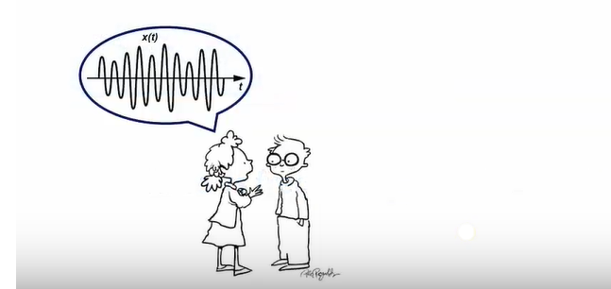
Technical Contents: Time Domain
The real world happens in the time domain
The independent variable is time, denoted by“t”

Slide 4
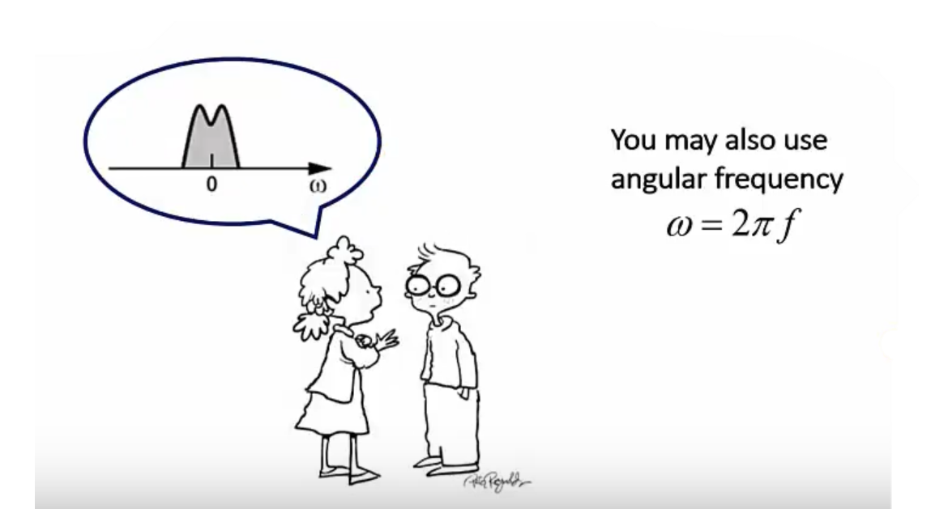
Technical Contents: Frequency Domain
Signals may be represented by frequency components
The independent variable is frequency“f”

Slide 5
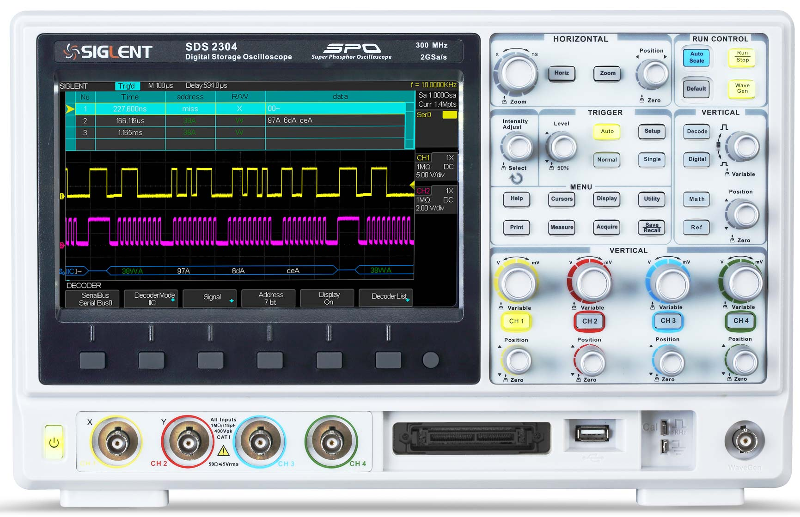
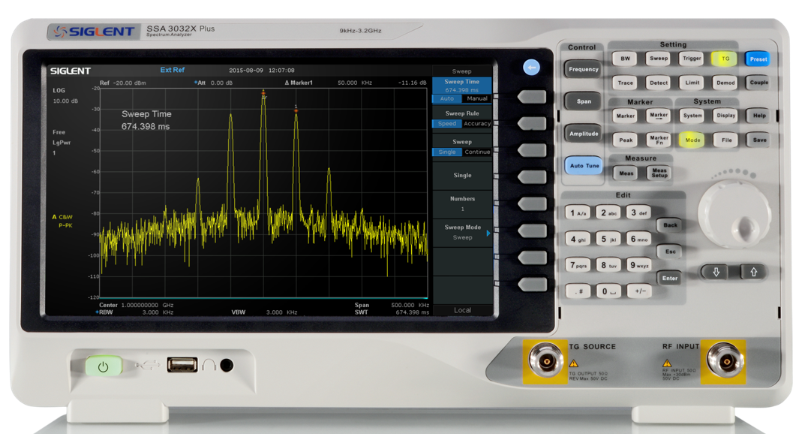
Time Domain vs. Frequency Domain
What is the instruments should you use for measuring the signal in the time domain or the frequency domain?
Oscilloscope for time
Spectrum analyzer for frequency

Slide 6
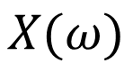
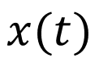
Time Domain vs. Frequency Domain
The two representations are related through the Fourier Transformation and both contain the same information
Fourier
$$x(t)$$
$$X(ω)$$
Remember by changing the signal in one domain, its representation in the other domain changes as well

Slide 7
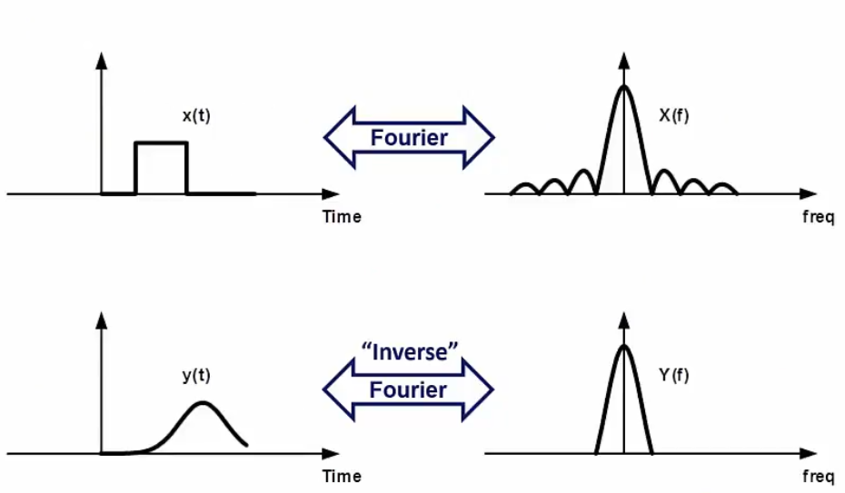
Time Domain vs. Frequency Domain

Slide 8
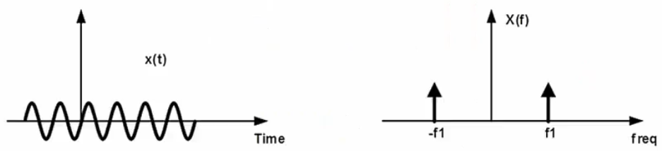
Time Domain vs. Frequency Domain
All real (measure in the lab) signals have this negative frequency components as well. It is called the image
A sinusoidal signal is often called a single-tone because its frequency domain representation contains only one frequency

Slide 9
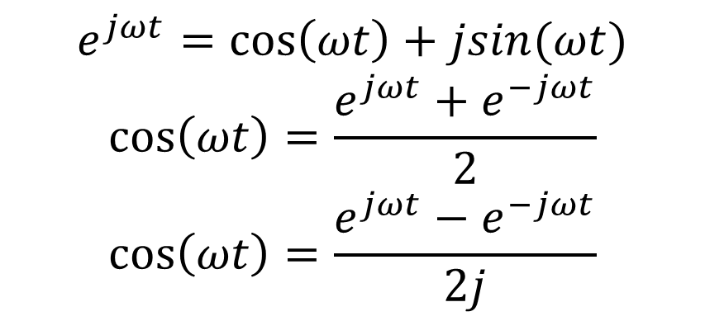
Time Domain vs. Frequency Domain
Negative Frequency
$$e^{jωt}=\cos\left(ωt\right)+jsin(ωt)$$
$$\cos\left(ωt\right)=\frac{e^{jωt}+e^{−jωt}}{2}$$
$$\cos\left(ωt\right)=\frac{e^{jωt}−e^{−jωt}}{2j}$$

Slide 10
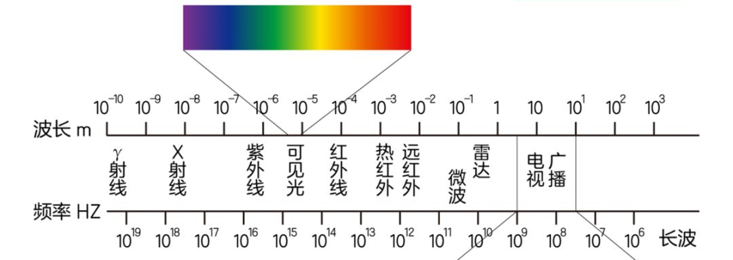
Spectrum
常用雷达信号频率

Slide 11
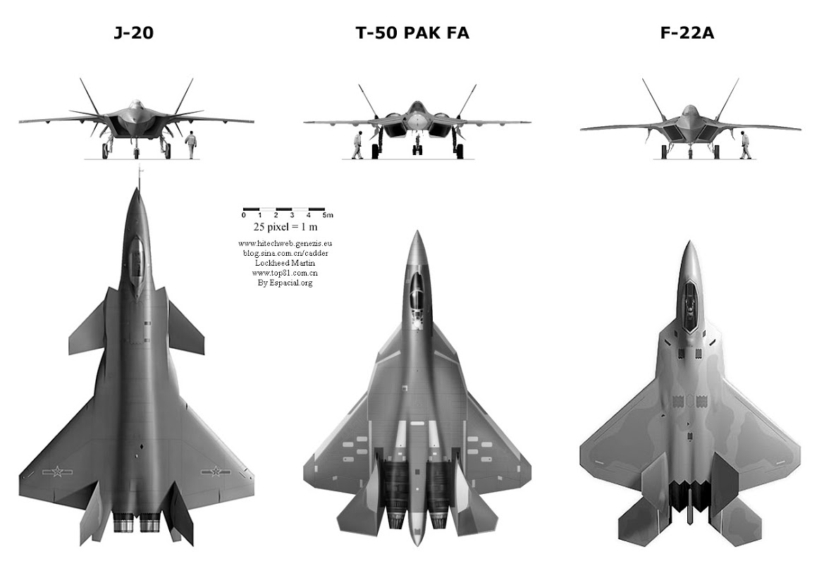
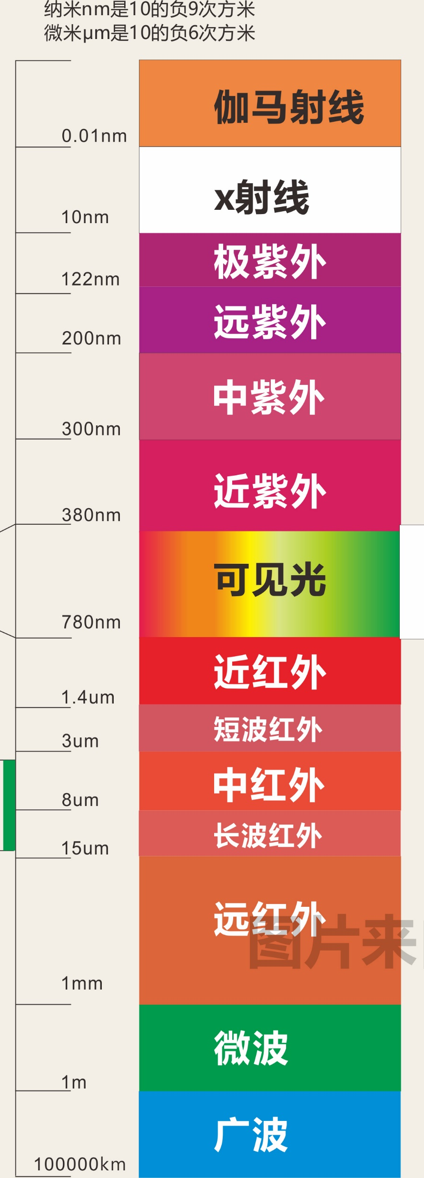
Stealth Aircraft

Slide 12
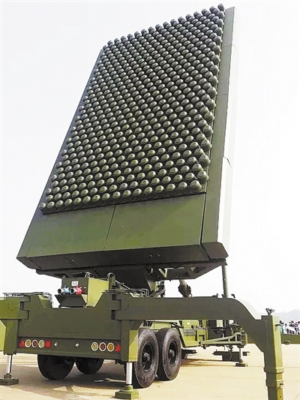
Decimeterwave Radar
概述：JY-26 远程对空警戒引导雷达
JY-26远程对空警戒引导雷达工作于UHF频段(0.3-3 GHz)，以常规空气动力目标、隐身目标为主要作战对象，能够提供空中目标的方位、距离、高度和速度等信息，独立负担中高远程对空警戒和指挥引导情报保障工作任务，兼顾战术弹道导弹的预警和跟踪
主要作战使命
具有频段反隐身优势
采用二位有源数字阵列
具有较强的对抗有源和无源干扰能力
具有一定的目标分类能力
集成化设计、满足多种运输及快速架设要求，可灵活机动部署

Slide 13
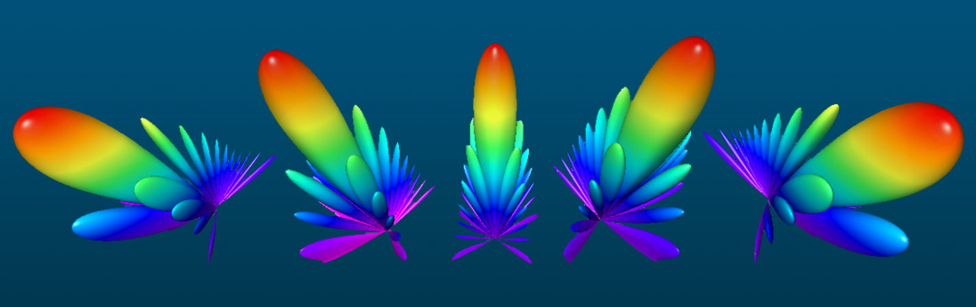
Spatial Domain
Spatial domain ：空域
天线方向图（Antenna Radiation Pattern）

Slide 14
How to distinguish two signals?
In signal processing, a filter is a device or process that removes some unwanted components or features from a signal.
——Wikipedia

Slide 15
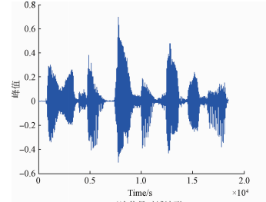
Filter
Time domain filtering

Slide 16
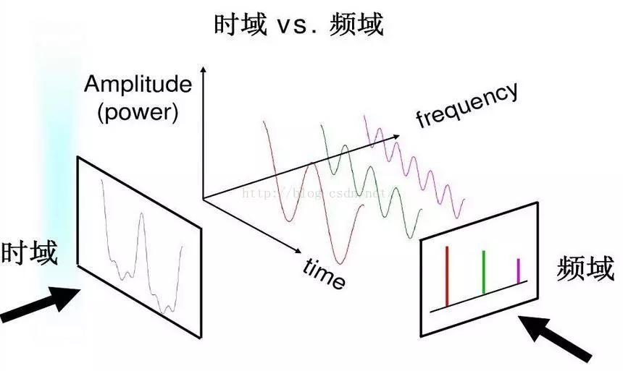
Filter
Frequency domain filter

Slide 17
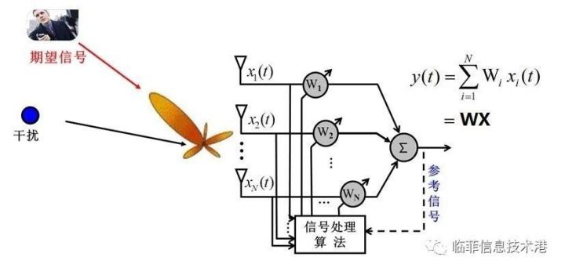
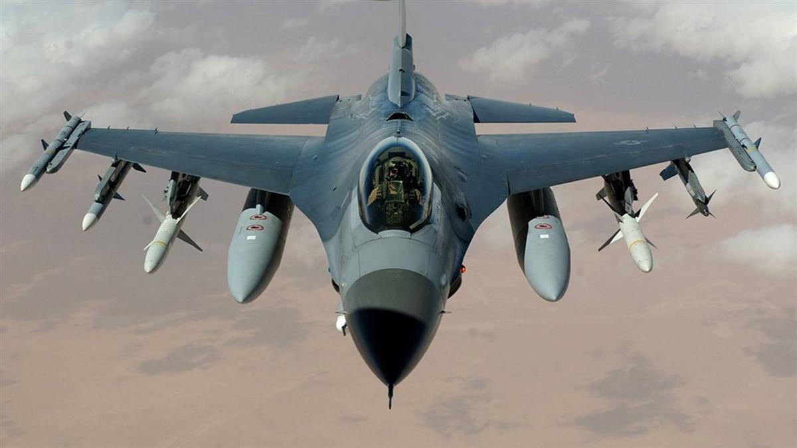
Filter
Spatial domain filter
目标
Smart/Adaptive Antenna

Slide 18
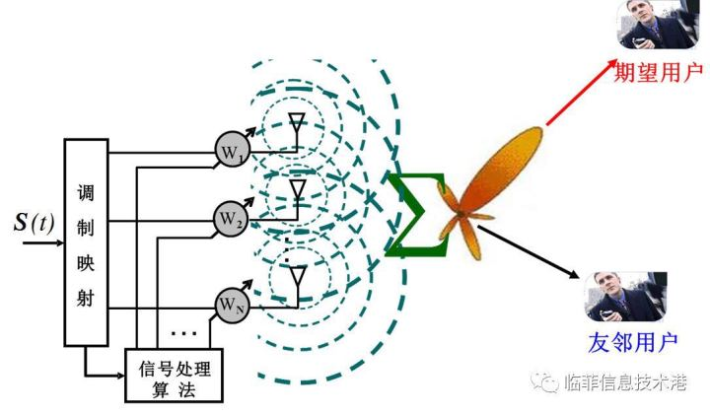
Filter
Spatial domain filter
Smart/Adaptive Antenna

Slide 19
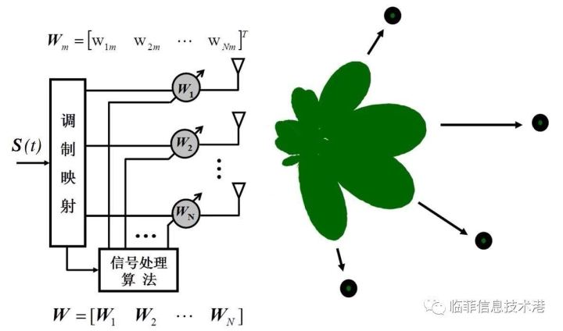
Filter
Spatial domain filter
Smart/Adaptive Antenna

Slide 20
Technical Terms
domain 域
angular frequency 角频率
low/high/band –pass filter 低/高/带通滤波器
adaptive 自动适应的
adaptive/smart antenna 自适应/智能 天线
antenna beam 天线波束
antenna pattern
华为Mate30pro: 7680fps 超级慢动作拍摄

